Slide 1

Ergonomics
for web specfications
Presented by
Oussema ben Ayech
under the supervision of Dr Aicha Ben Salem

Slide 2
Plan
Introduction
1
2
3
4
5
6
7
Why ergonomics matter in web design
Key Principles of Ergonomic Web Design
Real-World Case Study
How to Fix Bad Ergonomics
The Future of Ergonomics
Conclusion

Slide 3
Introduction

Slide 4

What is Ergonomics :
The study of designing systems, tools, and environments to fit the needs, abilities, and limitations of the people who use them. It focuses on optimizing interactions between humans and their surroundings to enhance comfort, efficiency, safety, and overall well-being. In simple terms, ergonomics ensures that tasks, products, or spaces—from chairs to software interfaces—are tailored to human physical and cognitive capabilities.

Slide 5

Ergonomics in Web :
Ergonomics in web design shapes interfaces to fit human physical and cognitive needs, minimizing strain and frustration. It prioritizes readability, intuitive navigation, and accessibility standards (e.g., WCAG) to ensure inclusive, effortless interactions.

Slide 6
Why ergonomics matter in web design

Slide 7

It prevents physical strain (eye fatigue, repetitive clicks), reduces mental frustration (confusing layouts), and ensures inclusivity (accessibility for all abilities).
Ignoring it risks alienating users, legal penalties, and lost revenue. Good ergonomics = happier users, better results.
Ergonomics in web design ensures interfaces work with users, not against them.

Slide 8
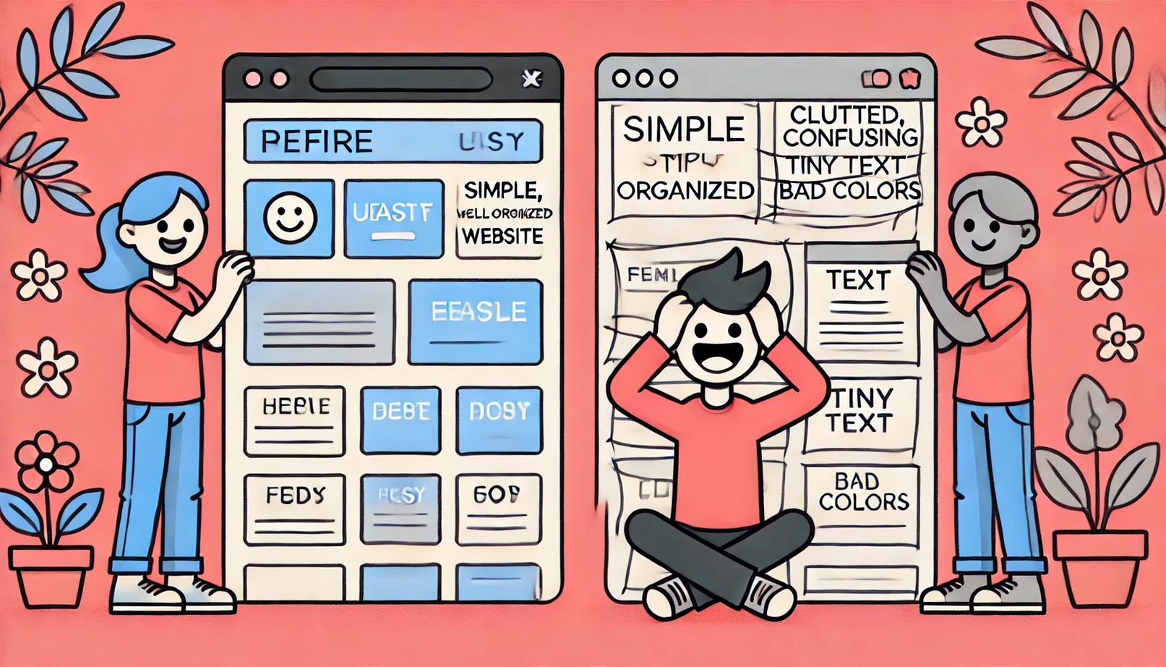
How important Ergonomics in Web design

Slide 9



What provide for the end user
Comfort & Efficiency
Adaptability & Responsiveness
Usability & Accessibility
Mobile-friendliness 📲 – Works smoothly on any device.
Flexible design 🔄 – Adapts to different screen sizes.
Consistent experience ✅ – Looks and functions well across platforms.
Easy navigation 🚀 – Menus and buttons are intuitive.
Accessibility for all 🌍 – Supports users with disabilities.
Readable content 🧐 – Good font size, contrast, and spacing.
Faster interactions ⏩ – Quick loading, responsive design.
Less frustration 😤 – No clutter or confusing layouts.
Reduced eye strain 👀 – Proper colors, spacing, and dark mode.

Slide 10
Key Principles of Ergonomic Web Design

Slide 11
Readability :
Clear typography (16px+ fonts, 1.5 line spacing).
Responsive & Mobile-First :
Prioritize thumb-friendly layouts (large buttons, spaced elements).
Accessibility Compliance :
Follow standards like WCAG (color contrast, keyboard navigation).
Feedback & Error Handling :
Confirm actions (e.g., “Undo Delete”).
Keys for an ergonomic web design
Minimize Physical Strain :
Reduce repetitive actions (auto-fill forms, fewer clicks).
Intuitive Navigation :
Predictable paths (breadcrumbs, sticky menus).

Slide 12
Real-World Case Study

Slide 13

GOV.UK (UK Government Website)
Problem Before Redesign (2012):
Cluttered Layout: Overwhelming menus, jargon-heavy content.
Poor Accessibility: Low contrast, no keyboard navigation.
Mobile Unfriendly: Tiny text, broken layouts on phones.
Result: Users struggled to find critical services (e.g., tax forms, healthcare).
Ergonomic Fixes:
Simplified Navigation
Single-column layout, clear headings (e.g., "Renew Passport").
Accessibility Overhaul
High-contrast text (WCAG AAA compliance), alt text for icons.
Mobile-First Design
Thumb-friendly buttons, responsive grids.
Plain Language
Replaced legalese with simple phrases (e.g., "Apply for a visa" vs. "Immigration Form 12A").

Slide 14
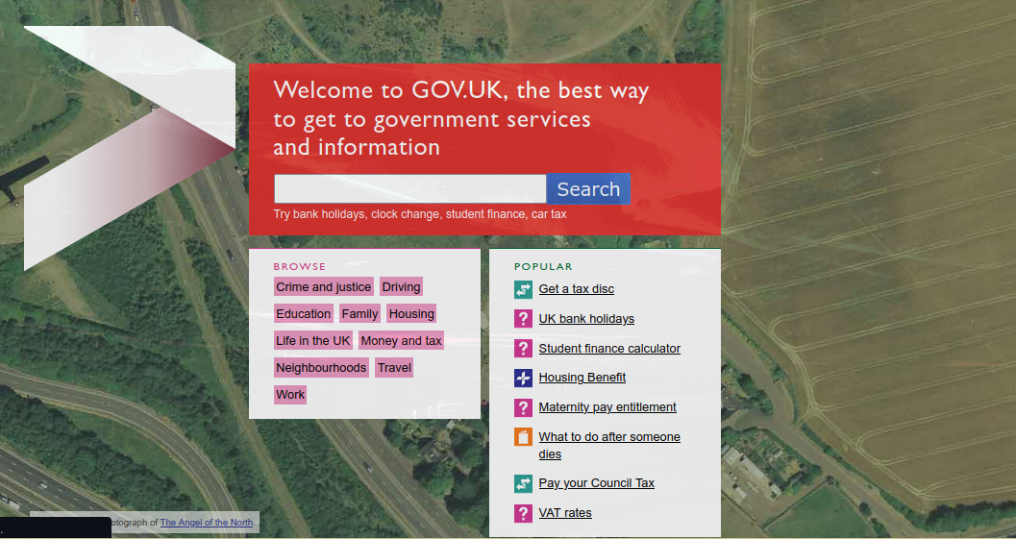
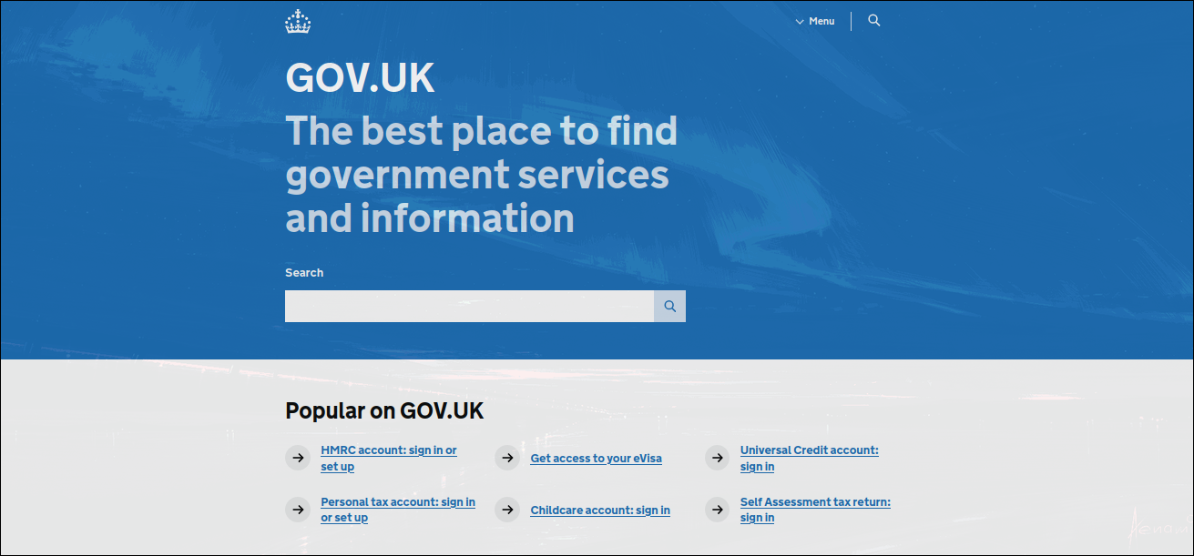
Before 2012 redesign
After 2012 redesign
Absurd
Too much colors
Unresponsive
Simple
Ergonomic
Responsive

Slide 15
How to Fix Bad Ergonomics ?

Slide 16

Clarity :
Clear headlines guide users instantly.
Engagement:
Strong headlines hook attention fast.
Visibility :
Keywords in headlines boost search ranking.
Conversion :
Action-driven headlines drive clicks.
Branding :
Tone reflects brand personality.
Accessibility :
Headlines aid screen reader navigation.

Slide 17
The Future of Web Ergonomics

Slide 18
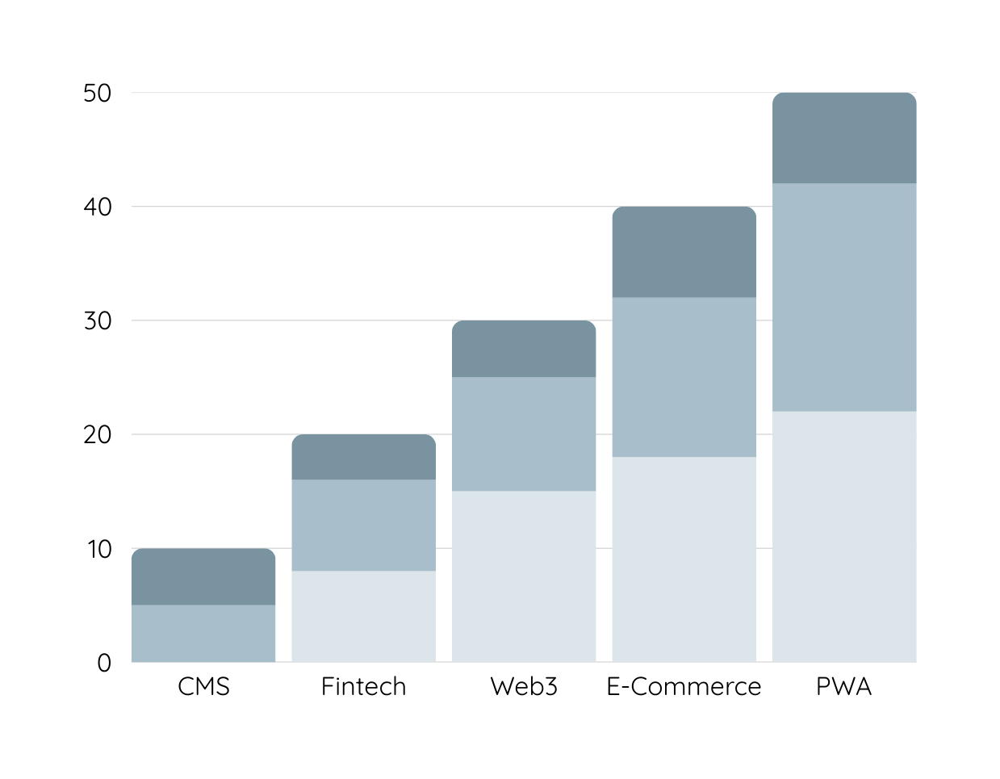
Web Ergonomics: Smarter, Adaptive, Invisible
AI-Powered Personalization:
Websites auto-adjust to you (e.g., left-handed mode, dyslexia-friendly fonts).
Voice & Gesture Control:
Navigate with "Scroll down" or hand waves
AR/VR Browsing:
3D interfaces for immersive shopping, learning, or workspaces.

Slide 19


Ethics & Inclusivity in Web Ergonomics
Biometric Adaptation:
Stricter rules for neurodiverse users (e.g., ADHD-friendly minimalism).
Example: Simplified layouts for better focus.
WCAG 3.0:
Stricter rules for neurodiverse users (e.g., ADHD-friendly minimalism).
Example: Simplified layouts for better focus.

Slide 20


Sustainable Design:
Low-energy layouts to reduce eye/device strain.
Example: Dark mode defaults for OLED screens.
Ethical AI:
No dark patterns → prioritize user well-being over engagement metrics.
Example: Transparent cookie consent, no manipulative pop-ups.

Slide 21
Conclusion

Slide 22

Ergonomics makes web design comfortable, clear, and inclusive. Fixes like bigger buttons and high contrast reduce frustration. The future includes AI, voice control, and ethical design. Let’s build a web for everyone!!.

Slide 23
Thank you

